Slide 4
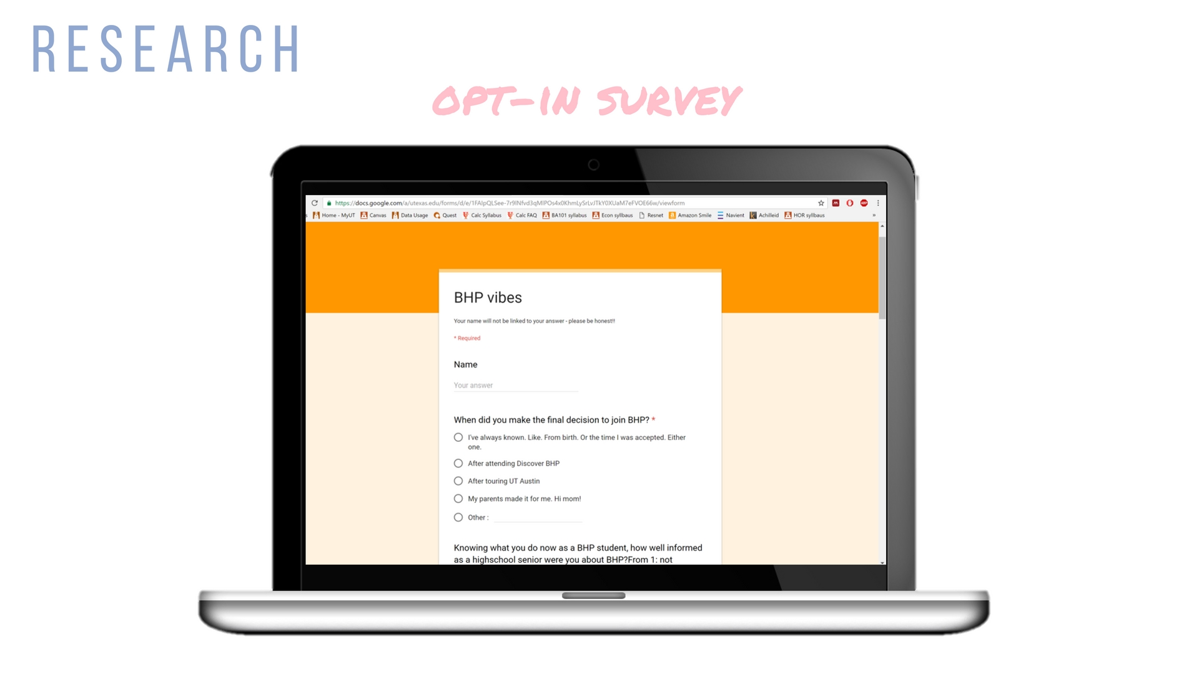

Slide 7
How smart the people are here, and how many opportunities there are (ex. IBanking: it doesn't compare to New England, but it's possible. In return for lacking IB, we get Austin start-ups and a wider view on the job market, so we don't get tunnel vision-ed into thinking everyone must do finance and get rich.
A full ride!
Small community, big resources and support
Better advertising in the northeast
Scholarship money TBH
The panels at Discover BHP
I kind of just applied spur of the moment so not really
Honestly, knowing how good the program is fully and also how nicely we are treated and the community aspect. Basically I was super uninformed before lol
if i knew it was very prestigious & not just another state school program

Slide 11
RELATABLE/PERSONAL
FORMAL
AESTHETICALLY PLEASING
FUNNY/HUMOROUS
INFORMAL

Slide 20
